Slide 1

EXPLORATORY
DATA ANALYSIS (EDA)
ON EMPLOYEE ATTRITION
https://colab.research.google.com/drive/1qZXhiIEjY68uleIOue-RCq1G9SviJbN-?usp=sharing
Team behind the analysis:
Bharath Bommeeshwar K - D22012
Praveen R - D22037
Ranjith N - D22042

Slide 2
About the dataset…
TARGET | ATTRITION
The dataset is about the employees attrition in an organization
There are 1470 employee details in the data set
There are no null/duplicate entries
Attrition is a target variable
There are 19 independent variables out of which 10 are Categorical and 8 are numerical.
PREDICTORS
CATEGORICAL
NUMERICAL
Business travel
Department
Education field
Environment satisfaction
Gender
Job involvement
Job level
Job satisfaction
Marital status
Work life balance
Over time
Monthly Income
Total working years
Years at company
Years in current role
Years since last promotion
Years with Current Manager
Distance from home

Slide 3
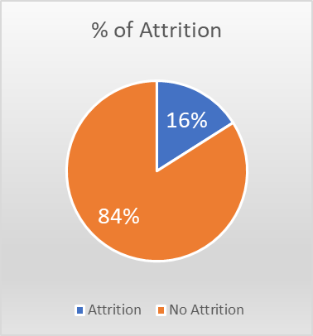
MAJOR INSIGHTS FROM THE UNIVARIATE ANALYSIS
Male-Female employees ratio = 60:40
50% of employees in the company are aged between 30 years and 43 years
50% of the employees have total working experience of 6 to 15 years
59% of the employees in this company has job involvement of 3 out of 4 scale in their jobs
Around 75% of the employees are at a job level of 1 and 2.
65% of the employees who either left the company or still works belong to R&D department
75 % of the employees works 7 years or more in the same role.
45 % of the employees who either still works or left the company are married
25% of the employees travel more than 14 kms everyday
.
How much is the attrition rate in this company?

Slide 4
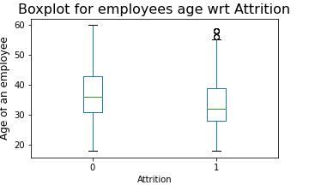
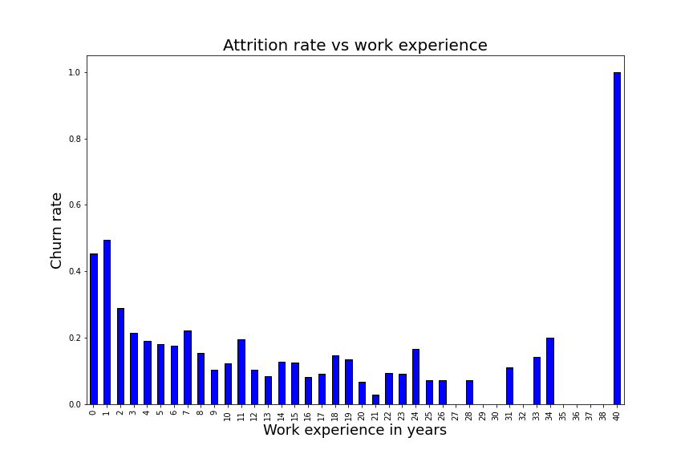
If an employee is Young, he/she will look
to move out for new opportunities
Hypothesis
50% of employees in the company are aged between 30 and 43 years.
Under our analysis, attrition rate of around 8% is seen for young age group between 28 and 38 years.
Possible causes:
Job search of Young age/less experienced employees will be high as they seek new opportunities for their career developments / to switch roles
There are more chances that Employee with more experience churns less
Hypothesis
Under our analysis, average total working years of the employees in this company is around 11 years.
Average income of employees having experience above 11 years is 10k dollars whereas below 11 years is 4k dollars.
Possible causes:
Highly experienced employees might be in the top roles and their monthly income will also be high leading to less churn rate

Slide 5
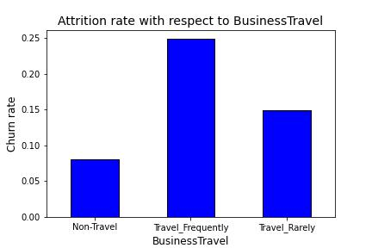
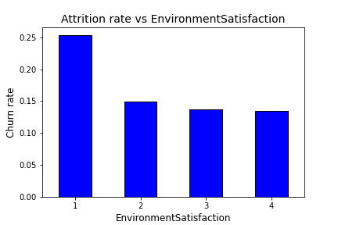
If Employee travels frequently he/she might think of leaving the job
Hypothesis
Under our analysis,19% of the employees in the company travel frequently.
25% attrition rate is observed among them; whereas the 10% of non-travel employees has the attrition rate of only 8%.
With respect to gender, there is no significant difference both
attrites at the same rate
Possible causes:
Employees with frequent travel seems to have low job satisfaction.
If an employees is not satisfied with environment , chances of churning is more
Hypothesis
Under our analysis, in this company close to 20% of the employees have given a lowest rating of 1 (On a scale of 4)
They got a churning rate of over 25% .
But employees who rated higher environment satisfaction (above 1)has got almost similar attrition rates.
Environment satisfaction is having very less/no impact on the attrition.

Slide 6
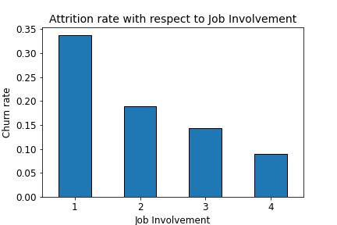
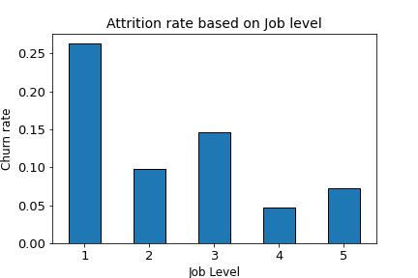
There are chances that Employees with lesser job involvement churns more
Hypothesis
Under our analysis, Out of all the employees, 59% of the them are in 3 out of 4 scale in their jobs.
P(employee leaving the job | job involvement=1) is 0.33
There are indications that employee with lower job satisfaction attrites more
If the employee is in the lower job level, he
/she might leave the job
Hypothesis
Under our analysis, around 75% of the employees are at a job level of 1 and 2.
Employees at job level 1 have got a higher churn rate of 26%.
It can be see that employees at lower levels tends to leave the job more than the ones at higher grades.

Slide 7
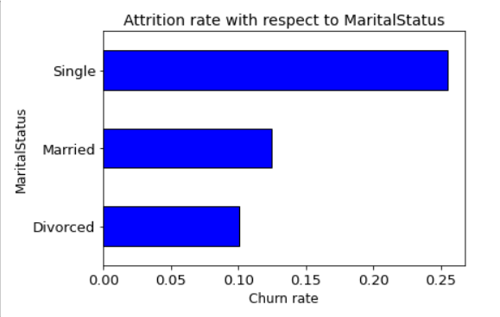
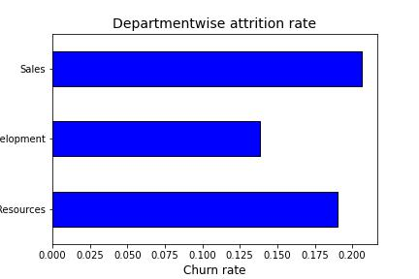
Bachelors may leave the job most
Hypothesis
Under our analysis, 32 % of the employees who either still works or left the company are bachelors
Probability of employees attrition given that the marital status single is 0.25 .
Employees in Sales department may churn
more
Hypothesis
Under our analysis, 65% of the employees who either left the company or still works belong to R&D department
The attrition rates are similar for the sales and HR department, there is no bias among the departments wrt attrition
Departments have very less/no impact on the attrition rate.

Slide 8
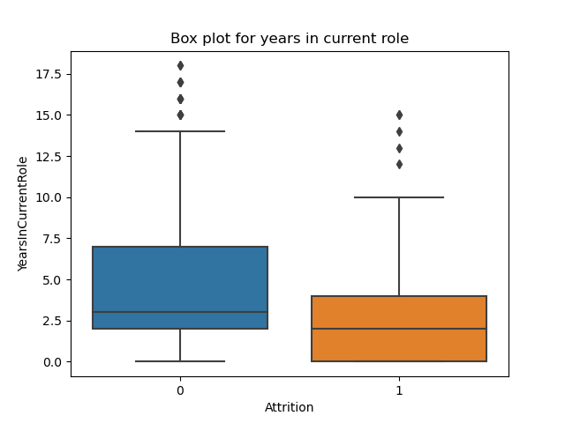
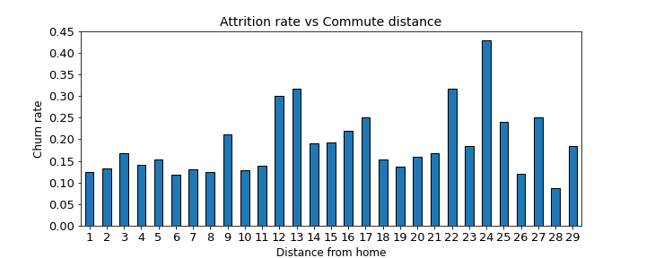
There are chances that employees working
in a same role for many years may churn
more
Hypothesis
Under our analysis, half of the employees of this company works in the same role for 3 years
Employees who works less no of years in the current role attrites more,
Possible causes:
This might be due to job switch for high salary package or for more job opportunities
Employees who commute farther
churns more
Hypothesis
Under our analysis, the average commute distance travelled by the employees every day is around 9 kms
Employees those commutes more than 20kms tends to attrite with a probability of 0.22

Slide 9
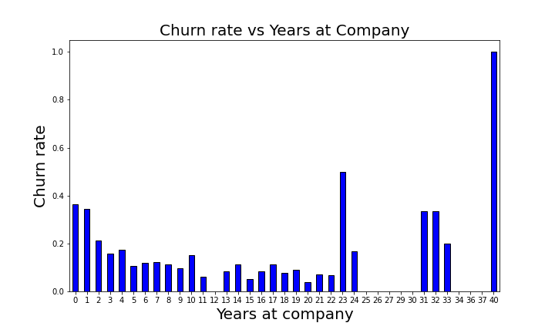
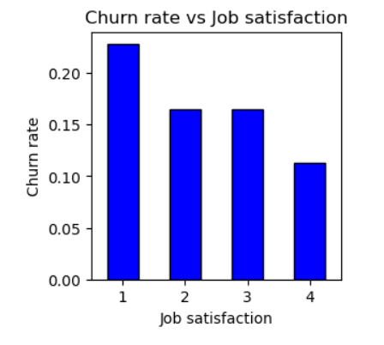
Employees staying in same company for
more number of years attrite less
Hypothesis
Under our analysis, it can be seen that with the increase in employees stay in this company the attrition rate decreasing
Attrition Peaks at higher no of working years may be due to employees retirement age
Attrition Peaks at higher no of working years may be due to employees retirement age
Less job satisfied employees could leave the
company sooner
Hypothesis
Under our analysis,more than 60% of the employees who either left the company/still works are satisfied with their jobs.
Employees with lowest job satisfaction of 1 are churned more from this company.
But the Employees with job satisfaction above 1 have similar churn rate thus it has very less/no impact on the attrition rate.

Slide 10
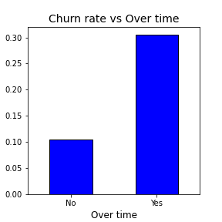
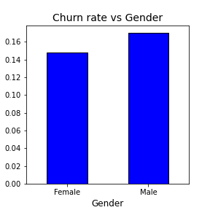
Employee working Overtime are more
likely to leave
Hypothesis
Under our analysis, in this company there are 415 employees who works overtime
P(Employee being attrited | works overtime) is 0.3
On further analysis, we found that there is no gender bias with respect to overtime and attrition rate
Gender bias could be there in a company leading to more female attrition
Hypothesis
Males - 882, Females-588 in 60:40 ratio
No gender bias when it comes to overtime
Attrition rate for both male and female employees are nearly close to 16%.
Thus, no gender bias in the company

Slide 11
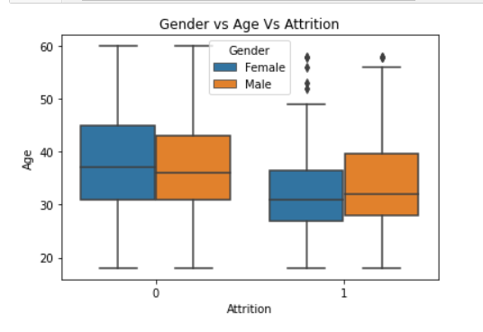
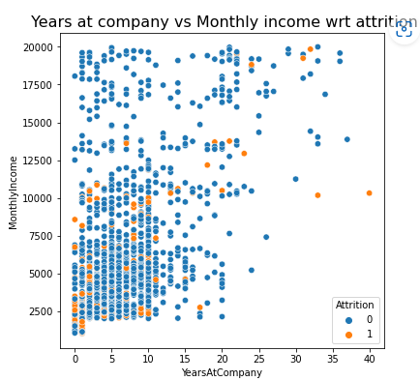
There are more chances that Young male employees moves out for new opportunities
Hypothesis
Under our analysis, both males and females of lower age category (around 28-35) has got higher attrition rate
As the age increases, the employees stay in the company increases
On further analysis, high attrition rate is also seen for the young age(less than 35 years)and low experienced employees in this company
Employees getting lower salary with
higher work experience may attrites more
Hypothesis
Under our analysis, with the increase in years at company monthly income increases and attrition rate gradually reduces

Slide 12
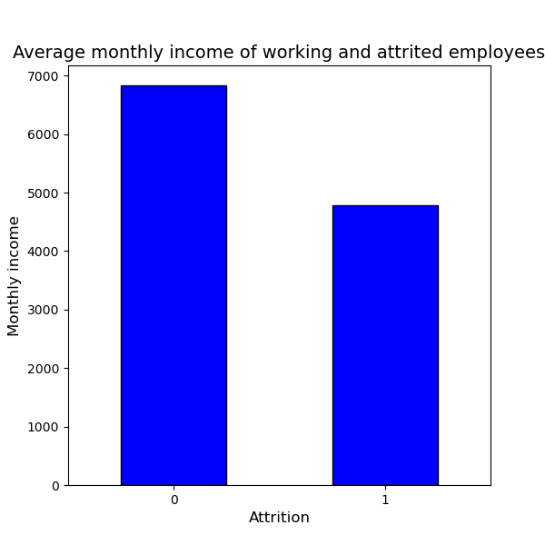
Employees who are paid with less
salary might attrite
Hypothesis
Under our analysis, the average salary of the employee in this is around 6.5k dollars.
Employees who were attrited got an average salary of close to 4.8k which is almost 30% lesser than the average salary of non-attrited employees (close to 6.8k).
Possible causes:
It can be seen that employees of younger age getting low salary at their initial career churns more

Slide 13
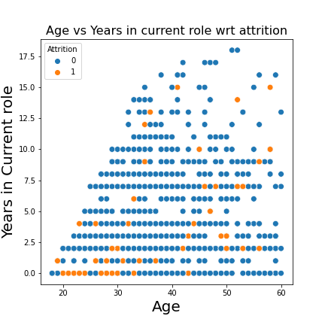
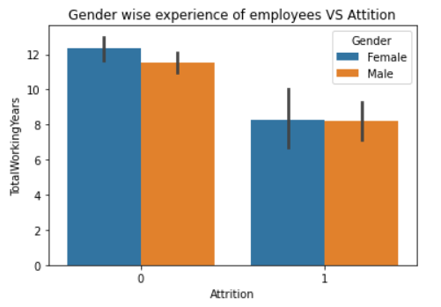
Young Employees with experience of 1 year or
lesser in current role attrite.
Hypothesis
Under our analysis,employees having age lesser than 35 years and experience in current role lesser than 2 year
contributes to 1/3rd of attrition.
What is the relation between gender and
total work experience of employees with
respect to attrition?
Hypothesis
Under our analysis, the relation between gender and total work experience of the employees is uniform and has least/no impact on the attrition

Slide 14
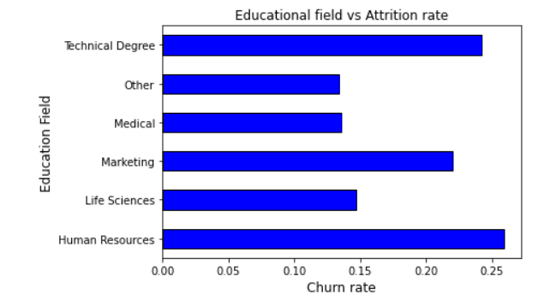
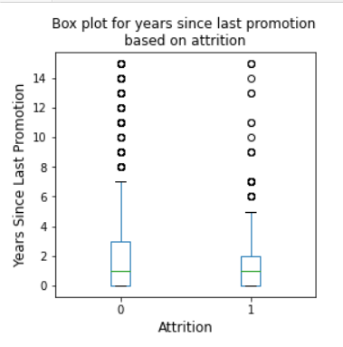
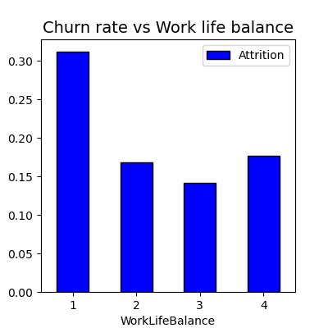
OTHER FACTORS WHICH HAS VERY LESS IMPACT ON ATTRITION

Slide 15
From our overall analysis, the variables which are majorly impacting & least influencing the attrition are listed below:
Variables majorly impacting the Attrition
Gender
Educational field
Department
Environment satisfaction
Years since last promotion
Job satisfaction
Work life balance
Age
Total working years
Business Travel
Years in current role
Monthly income
Variables with very less/no impact on Attrition

Slide 16
Recommendation for optimal attrition
Prioritizing professional growth of young professionals / freshers
Increasing the monthly salary of the employees
Offer competitive compensation and benefits
Timely promotions
Flexible working cultures
Extra perks for the employees who travel
Showing serious concerns on job satisfaction of the employees
Preferring more married employees while hiring

